Slide 1
ALL IN ONE COVID-19
THE ONE STOP PLATFORM TO COMBAT THE INVISIBLE ENEMY
ANYTIME ANYWHERE
Course Title: Computer Programming. Course Code: CS110
Semester: B. Tech 2nd Sem Section: S2
Course Instructor: Marwa Mohiddin

Slide 2
CONTENTS
The Team
Introduce the team
The Platform and Features
Introduce the Platform and the features
The Journey
Ideation and Analysis, Design, Code, Test, Demo
Q & A
Questions and Answers

Slide 3

THE TEAM
Introducing The Team
Devika Harikrishnan
Viba R Udupa
Harshitha Reddy
Spandana Bhat K
Roll No:ME226,
Cell #: 9113503488,
Email id: devikaharikrishnan.191me226@nitk.edu.in
Roll No:ME291,
Cell #: 9740871536,
Email id: vibarudupa.191me291@nitk.edu.in
Roll No:ME294,
Cell #:720467468,
Email id:
yharshithareddy.191me294@nitk.edu.in
Roll No: ME186,
Cell #: 9481266475,
Email id:
spandanabhatk.191me186@nitk.edu.in

Slide 4

THE PLATFORM
The All In One Covid-19 Platform
WHAT THE PLATFORM DOES
Covid-19 apart from being a global pandemic is a social economic crisis which has affected people from all sectors of the society. The All In One Covid-19 platform is a humble attempt from us to connect and empower people by providing right information and help them stay safe and healthy.
Here is a video of our platform.

Slide 5
FEATURES
The features of All In One Covid 19 Platform
FEATURES
1. Sign In/ Sign Up
2. Covid Case Updates Country and Worldwide
3. Self-Assessment
4. Safety Measures
5. Lockdown Updates
6. International News
7. Random facts to keep you entertained
8. Mini Games when you need a break
9. Lockdown Activities
10.Rating and review by the user

Slide 6
THE JOURNEY
How the platform evolved.
IDEATION AND ANALYSIS
DESIGN
CODE
TEST AND
GO-LIVE
Brainstorm and Analyze on what features we can include in the platform
Arriving at flowchart and design.
Split up tasks and code
Integrate , test, Go Live

Slide 7

THE DESIGN
Please find the flowchart attached

Slide 8
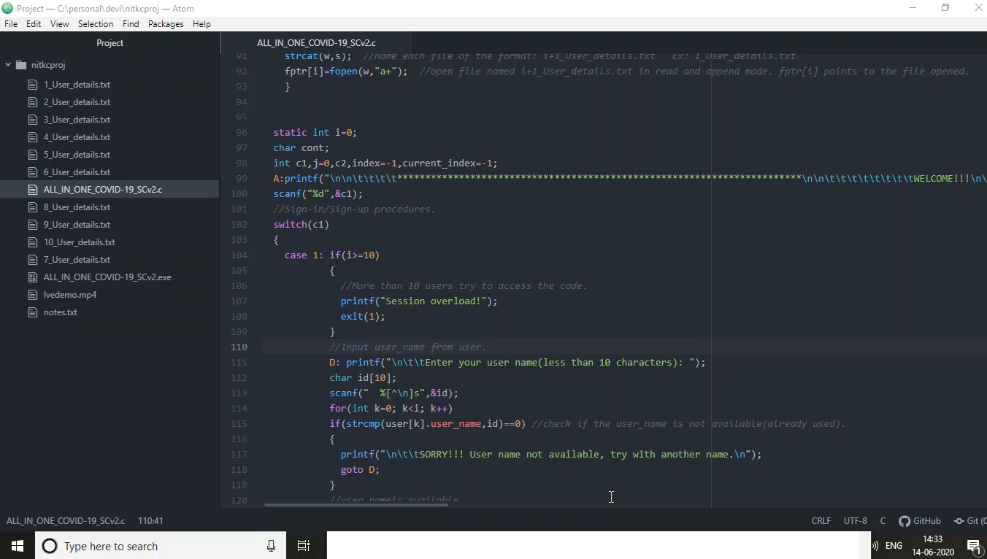
THE DEMO

Slide 9

SOFTWARE USED
The software used for the project.
Software
We used the below tools and software for our project
OVERLEAF
Draw.io
ADOBE ACROBAT
ATOM
MS OFFICE
C COMPILER

Slide 10

FEATURES USED IN C
The C programming language features we used.
Features in C which we used
We used the below C programming language features to build our platform
LOOP
INPUT OUTPUT
FUNCTIONS
STRUCTURES AND UNIONS
POINTERS
DATA TYPES
FILE HANDLING
STANDARD LIBRARIES-
stdio,stdlib,string,conio,time,ctype

Slide 11
BENEFITS
Benefits of the platform.
Gives Information on Current Covid Status In India and World Wide.
Let Us See How The Platform Helps People
Gives information on lockdown restrictions, safety measures
Entertainment in the form of games and news.
Information on Safety and Precaution.
Review and Feedback Sharing.

Slide 12
THANK YOU!
Any Questions?
All In One COVID-19

